Slide 1
ITSC 206: Advanced Networking for Offensive and Defensive Environments
Lecture 3: Advanced Routing Protocols
Harkirat Mann, ISS Instructor, SADT, SAIT

Slide 2
NETWORK LAYER PROTOCOLS

Slide 3


Slide 4
EXAMPLE:
Imagine you have a big city with many roads, and you want to send a package from one side of the city to the other.
Routers are like the postal workers of the internet, and they need to know the best route to take.
RIP helps routers share information about the roads (or paths) they know about. Each router tells its neighbors about the roads it knows and how long it takes to travel on them. The routers keep updating this information every once in a while. So, if a road becomes congested or blocked, routers can adjust their routes to avoid the problem.
Routers use a simple rule: they pick the route with the fewest "hops" or jumps between routers. You want to take the route with the fewest pit stops.
RIP routers share their routing information with each other, and they keep doing this so that they always have an up-to-date map of the network.

Slide 5
Routing as the process of determining the path for data to travel between devices on a network

Slide 6
ROUTING
Routing is the process of determining the most efficient path or route for data to travel between devices on a network.
It involves making decisions at network devices called routers to ensure that data packets reach their intended destinations accurately and in a timely manner.

Slide 7
ROUTING TABLE
A routing table is a set of rules, often viewed in table format, that's used to determine where data packets travelling over an Internet Protocol (IP) network will be directed.
This table is usually stored inside the Random Access Memory of forwarding devices, such as routers and network switches.

Slide 8
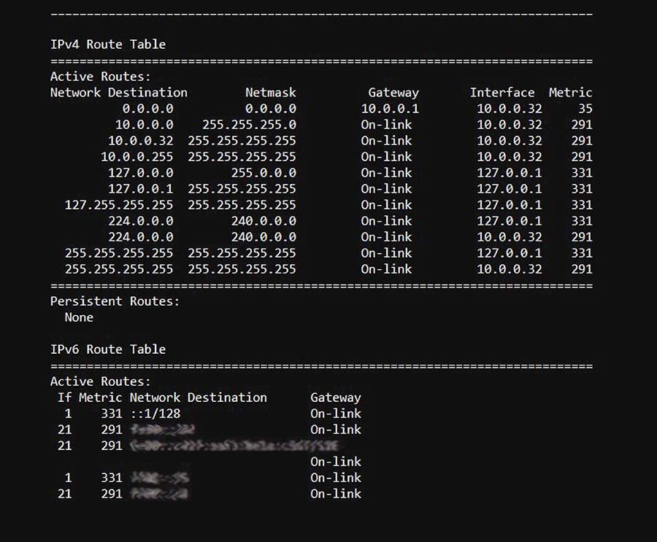

Slide 9
Why routing protocols are crucial for routers to make routing decisions

Slide 10
BECAUSE :
They provide a standardized set of rules and procedures that routers use to communicate with each other and share information about network topology and available routes. These protocols serve as the "language" that routers use to exchange vital information, such as:

Slide 11
Route Information: Routing protocols enable routers to share information about the available paths or routes to reach different destinations within a network. This information includes details like network addresses, hop counts, and metrics that help routers determine the best path for data.
Network Status Updates: Routers need to stay up-to-date with the status of network links and destinations. Routing protocols continuously exchange updates about the health and status of network connections, allowing routers to adapt to changes like link failures or network additions.

Slide 12
Path Selection: Routing protocols provide algorithms and metrics to assess the quality of available routes. Routers use this information to select the most efficient path based on criteria like speed, reliability, and cost.
Convergence: In dynamic networks where changes occur, such as adding new devices or links or encountering network failures, routing protocols help routers quickly adapt by recalculating routes. This process, known as convergence, ensures that data can continue to flow even when the network changes.

Slide 13
Scalability: For large and complex networks, routing protocols facilitate efficient scaling. They enable routers to handle a growing number of devices and routes while maintaining network stability and performance.
Load Balancing: Some routing protocols support load balancing, which allows routers to distribute traffic evenly across multiple paths to prevent network congestion and optimize resource utilization.

Slide 14
Routing Information Protocol (RIP)

Slide 15
RIP (Routing Information Protocol) is a dynamic routing protocol used in computer networking. Its primary purpose is to facilitate the exchange of routing information between routers within a network.
RIP is designed to help routers maintain and update their routing tables, which contain information about the best paths (routes) to reach various destinations in the network.
By sharing this routing information with each other, routers can collectively make informed decisions about how to forward data packets to their intended destinations.

Slide 16
ROUTING INFORMATION PROTOCOL METRICS
RIP uses a simple metric known as "hop count" to determine the best route, where the number of routers a packet must traverse to reach a destination is counted as the "hops.“
RIP routers exchange updates about these hop counts, allowing them to select the most direct and efficient paths to reach their destinations.
Maximum number of hops allowed: 15
A hop count of 16 is considered infinite and unreachable

Slide 17
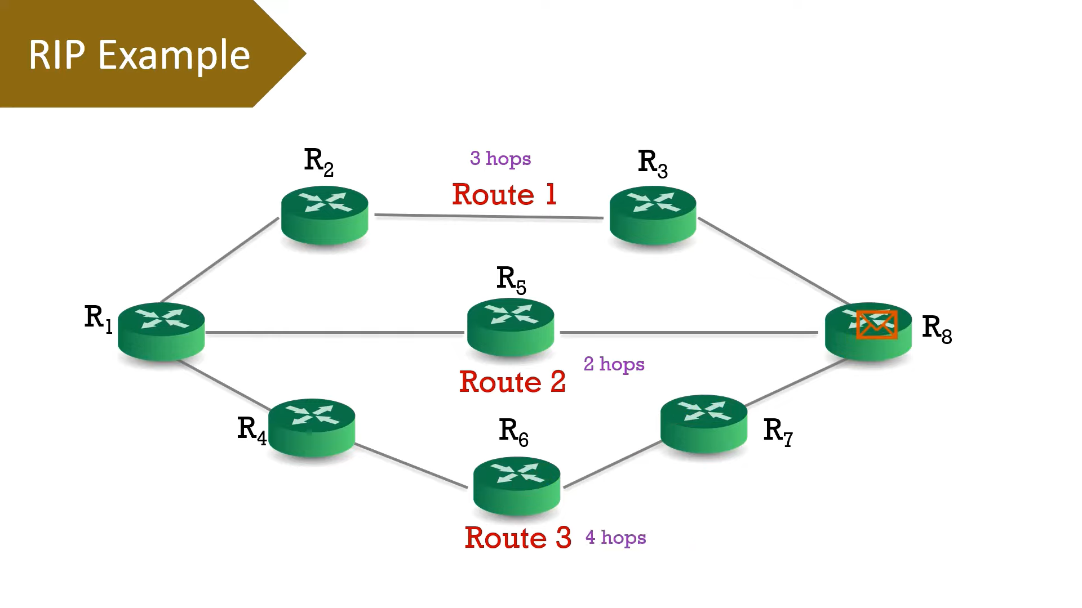

Slide 18
Routing update sent out every 30 seconds using
broadcast in version 1
multicast in version 2

Slide 19
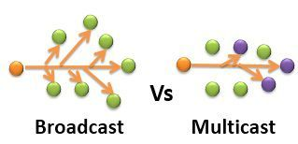
BROADCAST VS MULTICAST

Slide 20
Basic | The packet is transmitted to all the hosts connected to the network. | The packet is transmitted only to intended recipients in the network.
Transmission | One-to-all. | One-to-many.
Management | Broadcasting does not require any group management. | Multicasting requires group management to define the group of hosts/stations which will receive packets.
Bandwidth | Bandwidth is wasted. | Bandwidth is utilized efficiently.
Traffic | Unnecessarily huge amount traffic is generated in the network. | Traffic is under control.
Process | Slow. | Fast.

Slide 21
RIP Version 1 (RIPv1): In this older version, routing updates are sent out every 30 seconds using a broadcasting method. Broadcasting means that a router sends its routing updates to all devices on the network, and every device on the network listens for these updates. While simple, broadcasting can be less efficient in larger networks because every device has to process these updates, even if they aren't relevant.
RIP Version 2 (RIPv2): In the newer version, RIPv2, multicast is used instead of broadcasting. Multicast is a more efficient way to send routing updates. In this case, a router sends its updates to a specific multicast address, and only routers interested in that information listen to it. This reduces unnecessary network traffic compared to broadcasting and is better suited for larger networks.

Slide 22
RIP
The frequency of routing updates tends to be relatively noisy on network
Because updates are sent every 30 seconds, there is a tendency for all RIP routers to send updates within seconds of each other, creating a storm of updates every 30 seconds, particularly in version 1
Version 1 does not support router authentication, making it prone to attacks

Slide 23
ADVANTAGES OF RIP
Simplicity: RIP is a relatively simple protocol to configure and manage, making it an ideal choice for small to medium-sized networks with limited resources.
Easy implementation: RIP is easy to implement, as it does not require much technical expertise to set up and maintain.
Convergence: RIP is known for its fast convergence time, meaning that it can quickly adapt to changes in network topology and route packets efficiently.
Automatic updates: RIP automatically updates routing tables at regular intervals, ensuring that the most up-to-date information is being used to route packets.
Low bandwidth overhead: RIP uses a relatively low amount of bandwidth to exchange routing information, making it an ideal choice for networks with limited bandwidth.
Compatibility: RIP is compatible with many different types of routers and network devices, making it easy to integrate into existing networks.

Slide 24
DISADVANTAGES OF RIP
Limited scalability: RIP has limited scalability, and it may not be the best choice for larger networks with complex topologies. RIP can only support up to 15 hops, which may not be sufficient for larger networks.
Slow convergence: While RIP is known for its fast convergence time, it can be slower to converge than other routing protocols. This can lead to delays and inefficiencies in network performance.
Limited support for load balancing: RIP does not support sophisticated load balancing, which can result in suboptimal routing paths and uneven network traffic distribution.
Security vulnerabilities: RIP does not provide any native security features, making it vulnerable to attacks such as spoofing and tampering.
Inefficient use of bandwidth: RIP uses a lot of bandwidth for periodic updates, which can be inefficient in networks with limited bandwidth.

Slide 25
Small to medium-sized networks: RIP is normally utilized in little to medium-sized networks that have moderately basic directing prerequisites. It is not difficult to design and requires little support, which goes with it a famous decision for little organizations.
Legacy organizations: RIP is as yet utilized in some heritage networks that were set up before further developed steering conventions were created. These organizations may not merit the expense and exertion of overhauling, so they keep on involving RIP as their directing convention.

Slide 26
SCENARIO
Scenario: Imagine you are the IT administrator for a small office with several departments, each having its own subnet. You have a network with multiple routers, and you want to use RIP to enable routing between these subnets.
Practical Example:
Network Topology:
You have a small office with three departments: Sales, Marketing, and IT.
Each department is on a separate subnet:
Sales: 192.168.1.0/24
Marketing: 192.168.2.0/24
IT: 192.168.3.0/24
You have three routers in your network:
Router A: Connects to the Sales department (192.168.1.1).
Router B: Connects to the Marketing department (192.168.2.1).
Router C: Connects to the IT department (192.168.3.1).

Slide 27
Open Shortest Path First (OSPF)

Slide 28
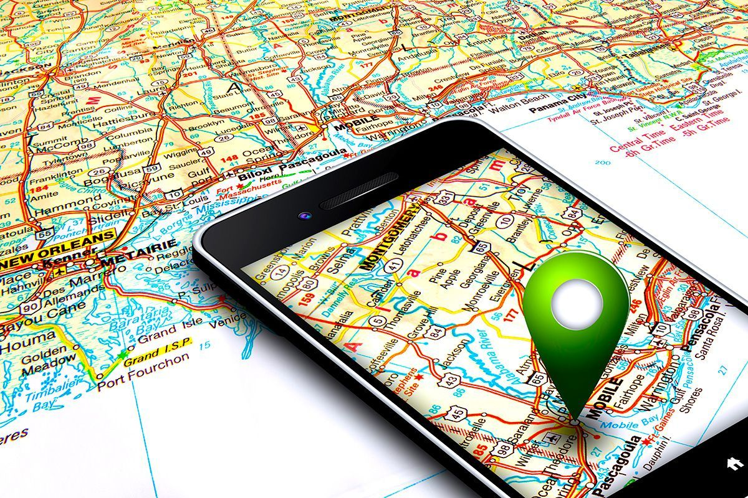
OSPF
Is
Like
A
GPS
For
The
internet.

Slide 29
OPEN SHORTEST PATH FIRST
OSPF, which stands for "Open Shortest Path First," is a routing protocol used in computer networks to determine the best path for data to travel between routers and across networks.
It is a link-state routing protocol that is part of the Internet Protocol (IP) suite and is widely used in large and complex networks, including the internet itself.

Slide 30
KEY FEATURES OF OSPF

Slide 31
Link-State Protocol: OSPF is a link-state routing protocol, which means that routers exchange information about the state and topology of their links. This information is used to build a detailed map of the entire network, allowing routers to calculate the shortest path to reach a destination.
Open Standard: OSPF is an open standard protocol, which means it is not tied to a specific vendor or proprietary technology.

Slide 32
Authentication: OSPF provides authentication mechanisms to secure the routing information exchanged between routers.
Scalability: OSPF is well-suited for large networks due to its hierarchical design and efficient routing table management.

Slide 33
WHY OSPF ?
Link-State Protocol: OSPF is a link-state routing protocol, which means routers have a detailed, up-to-date map of the entire network. This precision allows for accurate routing decisions and quick adaptation to network changes.
Hierarchical Network Design: OSPF supports hierarchical network design through the use of areas. This feature is particularly valuable in large networks as it reduces the amount of routing information exchanged and improves scalability.
Fast Convergence: OSPF is known for its fast convergence. When network changes occur (e.g., link failures or additions), OSPF routers quickly update their routing tables and adapt to the new network topology, minimizing downtime and disruption.
Load Balancing: OSPF supports load balancing by allowing routers to distribute traffic across multiple equal-cost paths. This ensures efficient utilization of network resources and prevents congestion on any single path.
Scalability: OSPF is highly scalable and can handle networks of various sizes, from small LANs to large, complex enterprise networks.

Slide 34
HOW OSPF WORKS ?
Network Partitioning into Areas:
OSPF networks are divided into areas, with one area known as the Backbone Area (Area 0). The backbone area connects all other areas in the OSPF network.
The use of areas reduces the complexity of routing tables and enhances scalability.
2. Link-State Advertisements (LSAs):
OSPF routers create and maintain a Link-State Database (LSDB) that contains detailed information about the network's topology.
Each router in OSPF generates Link-State Advertisements (LSAs) to describe its local state and the state of its directly connected links.
LSAs are periodically flooded throughout the OSPF area, allowing all routers to have the same view of the network.

Slide 35
3. Building the Link-State Database:
As routers receive LSAs from neighboring routers, they update their LSDBs.
Routers use the LSAs to create a complete map of the network, including all routers and links.
This map is known as the OSPF network topology.
4. SPF Algorithm:
OSPF routers use the Dijkstra SPF (Shortest Path First) algorithm to calculate the shortest path to reach all destinations in the network.
The algorithm takes into account the cost metric associated with each link. Lower costs represent faster links.
It calculates the shortest path tree, which is a visual representation of the optimal paths to all destinations.

Slide 36
5. Routing Table Calculation:
Based on the shortest path tree, OSPF routers populate their routing tables with information about the best paths to reach different destinations.
These tables contain information about the next-hop router and the outgoing interface for each destination network.
6. Neighbor Discovery:
OSPF routers establish neighbor relationships with other routers within the same OSPF area.
Neighbors exchange LSAs to keep each other informed about network changes.
OSPF uses a reliable protocol (such as OSPF Hello packets) to establish and maintain these neighbor relationships.

Slide 37
7. Network Changes and Convergence:
OSPF is designed to respond quickly to network changes. When a change occurs, such as a link failure or addition:
Routers affected by the change update their LSAs.
The change is flooded throughout the area.
Routers recalculate their SPF trees and update their routing tables.
This rapid convergence minimizes network downtime and ensures efficient routing.
Summarization and Route Aggregation:
OSPF supports route summarization, which allows multiple network addresses to be represented as a single, summarized route. This reduces routing table size.
OSPF also supports route aggregation, where multiple smaller subnets are advertised as a single larger subnet, improving efficiency.

Slide 38
ADVANTAGES OF OSPF
OSPF offers several advantages, including: Rapid convergence to adapt quickly to changes.
Scalability for networks of all sizes.
Support for complex topologies.
Route summarization for efficient routing tables.
Load balancing for optimal traffic distribution.

Slide 39
CHALLENGES TO OSPF
While OSPF is powerful, it comes with challenges, including: Complex configurations in large networks.
Resource consumption in extensive networks.

Slide 40
EX;
"Imagine you have a big treasure map, and you want to find the quickest way to reach the hidden treasure. You have a bunch of different paths to choose from, like roads, rivers, and bridges.
OSPF is like a magical helper that looks at the map and figures out the fastest way for you to get to the treasure
.Here's how it works:The Map: Think of all the paths as lines on your map. Each line is a different way to get to the treasure.The Magical Helper: OSPF is like a friendly wizard. You tell the wizard about all the paths, and the wizard uses magic spells to find the shortest path for you.
Fastest Path: The wizard looks at the map and checks the length of each path. It doesn't want you to take a long, twisty road when there's a short and straight one.
Changes in the Map: If something changes, like a new road being built or a bridge breaking, the wizard quickly updates the map and tells you the new fastest way to the treasure.
So, OSPF is like your treasure map wizard. It helps you find the quickest way to your treasure, and it's super fast at figuring it out, even if the map changes. That way, you can get to your treasure in no time!"

Slide 41
Border Gateway Protocol (BGP)- Backbone of Internet

Slide 42
AES
The Internet is a network of networks. It is broken up into hundreds of thousands of smaller networks known as autonomous systems (ASes). Each of these networks is essentially a large pool of routers run by a single organization.
If we continue to think of BGP as the Postal Service of the Internet, ASes are like individual post office branches. A town may have hundreds of mailboxes, but the mail in those boxes must go through the local postal branch before being routed to another destination. The internal routers within an AS are like mailboxes. They forward their outbound transmissions to the AS, which then uses BGP routing to get these transmissions to their destinations.

Slide 43
Protocol Terminology
Interior Gateway Protocol (IGP)– the protocol used to exchange routing information within an autonomous system.
Exterior Routing Protocol (ERP)– the protocol used to transfer exchange information between autonomous systems.
OSPF is IGP & BGP is ERP.

Slide 44
BORDER GATEWAY PROTOCOL

Slide 45
Border Gateway Protocol (BGP) is the postal service of the Internet. When someone drops a letter into a mailbox, the Postal Service processes that piece of mail and chooses a fast, efficient route to deliver that letter to its recipient. Similarly, when someone submits data via the Internet, BGP is responsible for looking at all of the available paths that data could travel and picking the best route, which usually means hopping between autonomous systems.
BGP is the protocol that makes the Internet work by enabling data routing. When a user in Singapore loads a website with origin servers in Argentina, BGP is the protocol that enables that communication to happen quickly and efficiently.

Slide 46
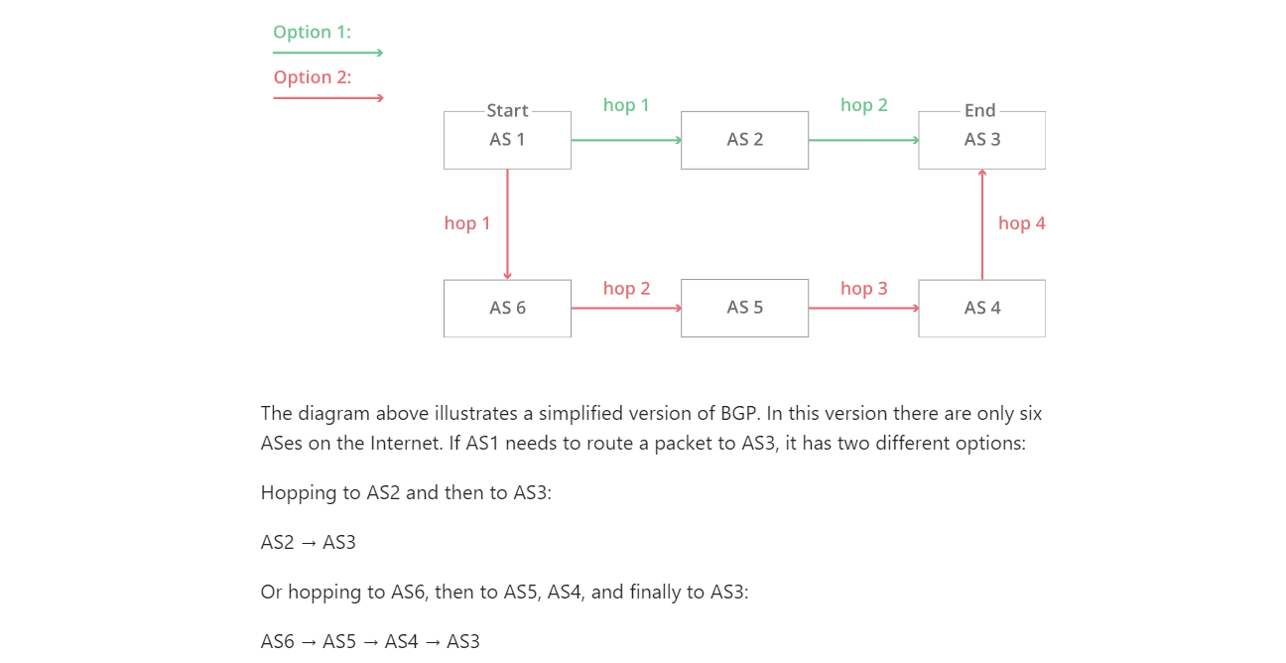

Slide 47
FEATURES
Path Vector Protocol: Think of BGP as a GPS for the internet. It knows all the roads (routes) and helps data take the best path to reach its destination. This means your favorite websites and videos load quickly because BGP finds the fastest way to get them to you.
Policy-Based Routing: BGP is like a traffic cop for the internet. It follows special rules set by experts to decide how data should travel. Just like real traffic cops make sure cars follow the right lanes, BGP makes sure data follows the right routes.
Scalability: The internet is like a huge playground with lots of kids (users), and BGP keeps things fun and organized. It can handle a ton of users and data without slowing down. So, even when millions of people are online, everything still works smoothly.
Inter-AS Routing: Imagine the internet is a big city with different neighborhoods (ASes). Each neighborhood has its own rules. BGP helps messages move between these neighborhoods and follow the right rules. It's like a tour guide making sure you visit your friends in different parts of the city safely.

Slide 48
HOW BGP WORKS ?
Autonomous Systems (ASes)
Imagine the Internet as a Giant Puzzle: The Internet is like a giant puzzle made up of many pieces. Each piece is called an Autonomous System (AS), and these ASes are like different neighborhoods in a city.
ASes Have Their Own Rules: Just like neighborhoods have their own rules, ASes have their own way of doing things. They are like little kingdoms on the Internet.
BGP Peering
ASes Talking to Each Other: BGP is like the messenger that helps these ASes talk to each other. It's like the postman delivering letters between neighbors.
Making Friends: ASes become friends with each other through a process called BGP peering. They share information about the routes they know and agree to help each other.

Slide 49
BGP Updates
Constant Updates: BGP is always checking to see if there are new roads (routes) or if some roads are closed. It sends updates to its AS friends whenever there's a change.
Like Traffic Reports: These updates are like traffic reports telling ASes the best way to send data. BGP makes sure data follows the latest information.
Best Path Selection
Choosing the Right Path: BGP is super smart. It looks at all the routes available and picks the best one for sending data. It's like choosing the fastest road to your friend's house on a map.
Factors to Consider: BGP considers many things, like the distance, speed, and reliability of the routes. It wants data to get to its destination as quickly and safely as possible.
AS Path Attribute
A Unique Trail: BGP uses something called the AS Path attribute. It's like a unique trail of ASes that data has passed through. This helps BGP avoid loops (where data goes in circles) and ensures data follows the right path.
Like Bread Crumbs: AS Path is a bit like leaving breadcrumbs on a trail. BGP can follow these breadcrumbs to make sure data doesn't get lost.

Slide 50
Here's how it works:
Internet Houses: Think of different houses in the city as different parts of the internet owned by different people or companies. Each house has its own rules and secrets.
BGP's Job: BGP helps messages and data travel from one internet house to another, sort of like delivering letters. But it's not just any delivery person; it's a super-smart one.
Choosing the Best Way: BGP figures out the best way to send data from one house to another. It's like finding the fastest route on a map, but this map has all the internet houses on it.
Changes and Updates: Sometimes, roads in the city can change or get blocked. BGP keeps an eye on this and tells data which way to go. It's like telling your friend the best way to your house if there's a detour.

Slide 51
EXTERNAL & INTERNAL BGP
Autonomous systems can also use an internal version of BGP to route through their internal networks, which is known as internal BGP (iBGP).
External BGP is like international shipping. There are certain standards and guidelines that need to be followed when shipping a piece of mail internationally. Once that piece of mail reaches its destination country, it has to go through the destination country’s local mail service to reach its final destination. Each country has its own internal mail service that does not necessarily follow the same guidelines as those of other countries.

Slide 52
DIFFERENCE BTW OSPF & BGP
OSPF | BGP
OSPF is an interior gateway protocol (IGP) designed for use within an autonomous system (AS) or a single organization's internal network. It is used to determine the best path for routing within the AS. | BGP is an exterior gateway protocol (EGP) used for routing between autonomous systems on the global internet. It is responsible for determining the best path to reach networks outside the local AS.
OSPF uses a link-state routing. | BGP uses a path vector routing algorithm.

Slide 53
Thank you everyone!
© 2017, Southern Alberta Institute of Technology. All rights reserved.
This publication and materials herein are protected by applicable intellectual property laws. Unauthorized reproduction and distribution of this publication in whole or part is prohibited.
For more information, contact:
Director, Centre for Instructional Technology and Development
Southern Alberta Institute of Technology
1301 16 Ave. N.W., Calgary, AB T2M 0L4

